Slide 1
Celestial Coordinate System & Telescopes
Tanveer Karim,
Banneker & Aztlán Institute and Harvard University
Day – 2, 26 June 2018

Slide 2
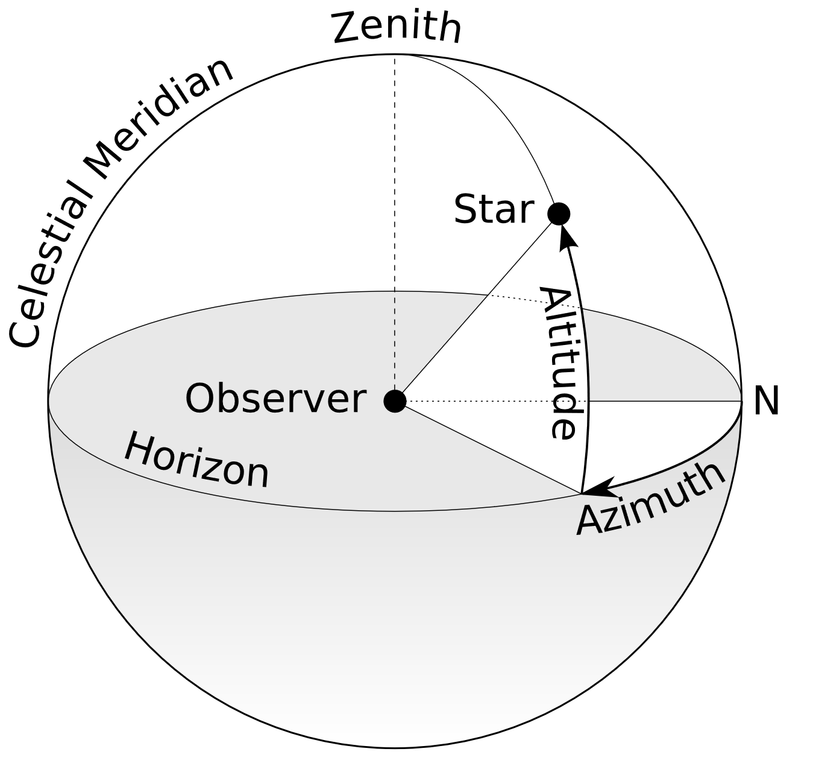
Horizontal Coordinate System
Horizontal Coordinate System

Slide 3
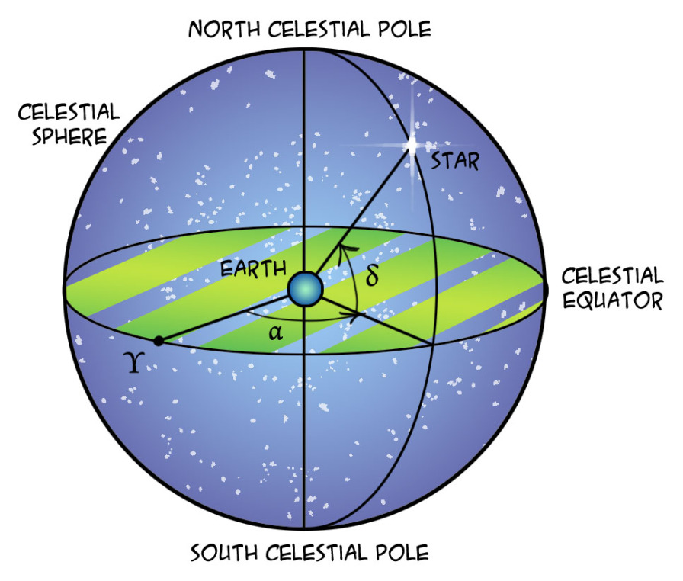
Equatorial Coordinate System
Equatorial Coordinate System
quantumredpill.wordpress.com

Slide 4
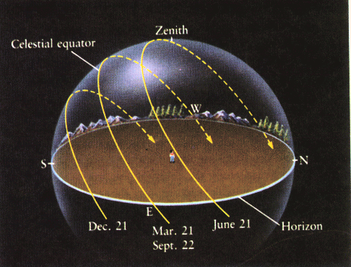
Path of the Sun – Solstices and Equinoctes
http://astro.wsu.edu/worthey

Slide 5
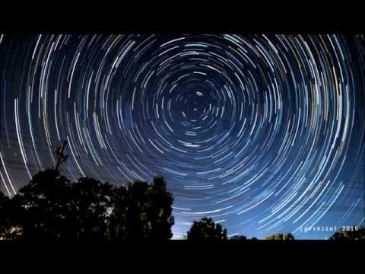

Slide 6
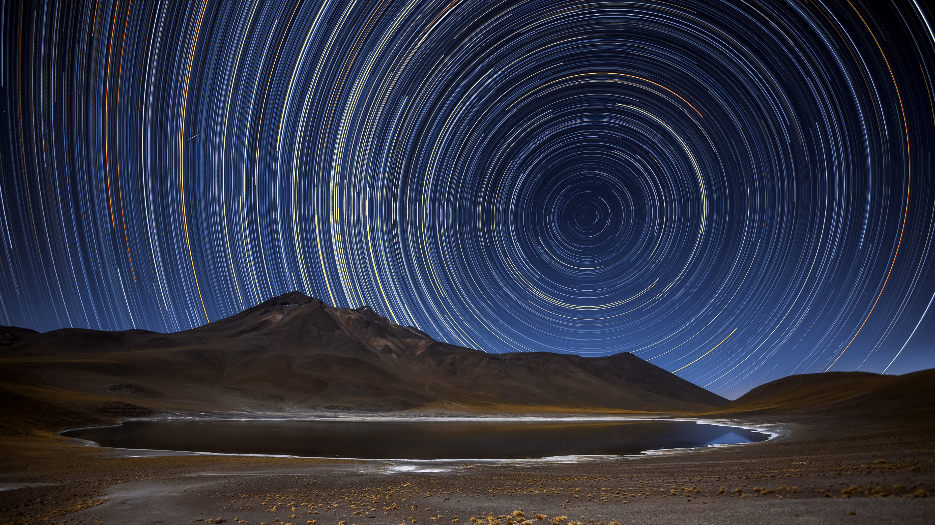
A. Duro/ESO
Notes:
Atacama

Slide 7
Rotating Sky Explorer
http://astro.unl.edu/naap/motion2/animations/ce_hc.html

Slide 8
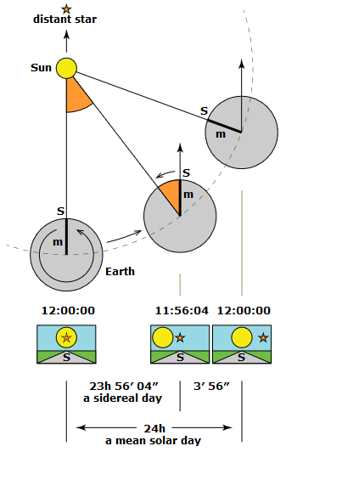
Sidereal vs Solar Time
Wikipedia

Slide 9
Sidereal vs Solar Time Simulator
http://astro.unl.edu/naap/motion3/animations/siderealSolarTime.html

Slide 10
Julian Date
http://aa.usno.navy.mil/data/docs/JulianDate.php

